Slide 1
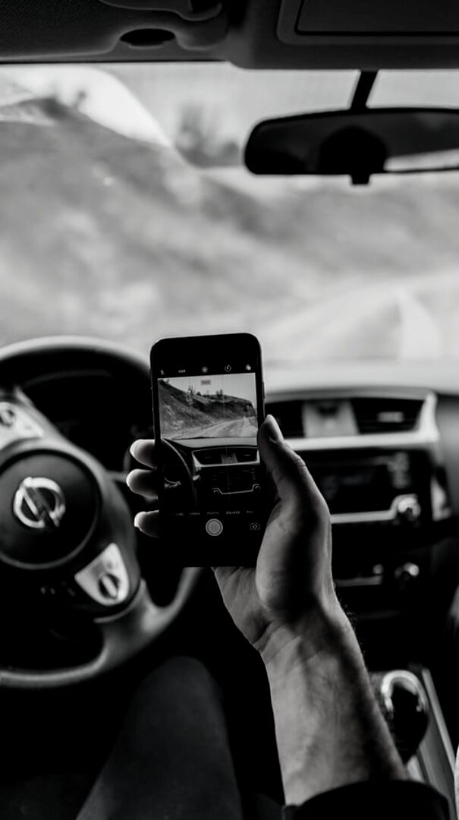
KING COUNTY, WASHINGTON
TRACKING PERCEIVED RISKS & DANGERS OF USING A CELL PHONE WHILE DRIVING
2018-2019
King County Target Zero Task Force with SurveyUSA

Slide 2
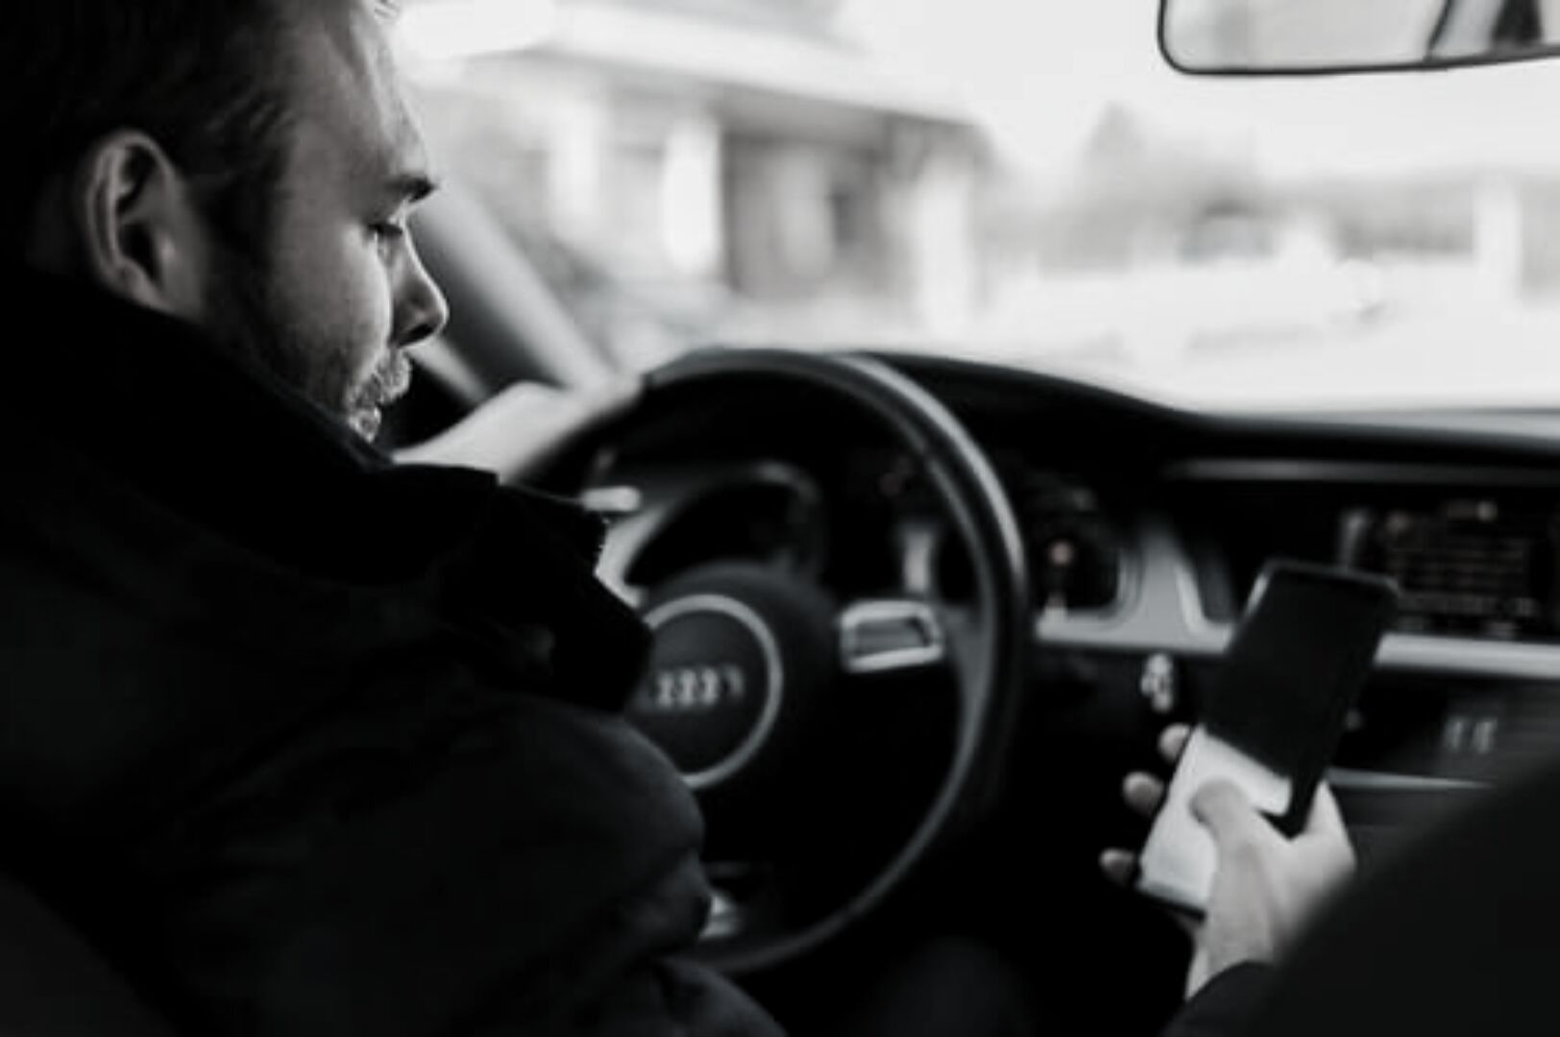
Overview
King County, Washington
SurveyUSA interviewed 984
driving-age individuals online on
behalf of King County Target
Zero Task Force, 05/23/19-06/06/19
Analysis of year-on-year sentiments
from 2018 to 2019 using identical
questionnaire on perceived risks
and dangers of using a cell phone
while driving
Questionnaire in 2019 modified to
offer Spanish-language version to
respondents - Hispanic/Latino/Mexican
respondents intentionally oversampled

Slide 3
DEMOGRAPHICS
984 DRIVING-AGE INDIVIDUALS, 2019

Slide 4
Other
2%
Black
6.1%
Multiracial
2%
Racial
Demographics
Hispanic
9.2%
Native Hawaiian/Pacific Islander
1%
984 driving-age
individuals, 2019
Asian
16.3%
White
62.2%
American Indian/Alaska Native
1%

Slide 5
HISPANIC, LATINO, AND
MEXICAN RESPONDENTS
INTENTIONAL OVERSAMPLING
RECRUITMENT TO THE SURVEY
Instead of being 9% of the raw
(unweighted) King County respondents,
as census suggests Hispanics should
be, Hispanics were 14% of completed
interviews, an oversample of 55%
96% of respondents recruited to survey
using identical incentives to 2018, with
additional 4% of all Hispanic respondents
recruited from a separate population of
Spanish-speaking King County residents
LANGUAGE
BENEFITS OF OVERSAMPLING
31% of Hispanic respondents completed
the survey in Spanish & 69% of Hispanic
respondents completed it in English
Considering how data is better with improved translated materials in multiple languages
Resulted in greater fidelity to 2019 Hispanic sample:
74% of Hispanics in the 2018 sample worked
outside of the home, compared to 56% in 2019
Hispanics commuting by car dropped from 82% to 61%, with bus commuting tripling from 10% to 31%

Slide 6
OUTREACH TO HISPANIC, LATINO, AND MEXICAN RESPONDENTS
OUTREACH IN
ENGLISH USING
IDENTICAL
INCENTIVES
WITH OPTIONS
TO TAKE
SURVEY IN
ENGLISH OR
IN SPANISH
OUTREACH IN
SPANISH TO
SEPARATE
POPULATION OF
SPANISH-SPEAKING
KING COUNTY
RESIDENTS TO
TAKE SURVEY
IN SPANISH
English email included an option to take the survey in English or in Spanish: effective
Only 1 respondent
completed the full survey

Slide 7
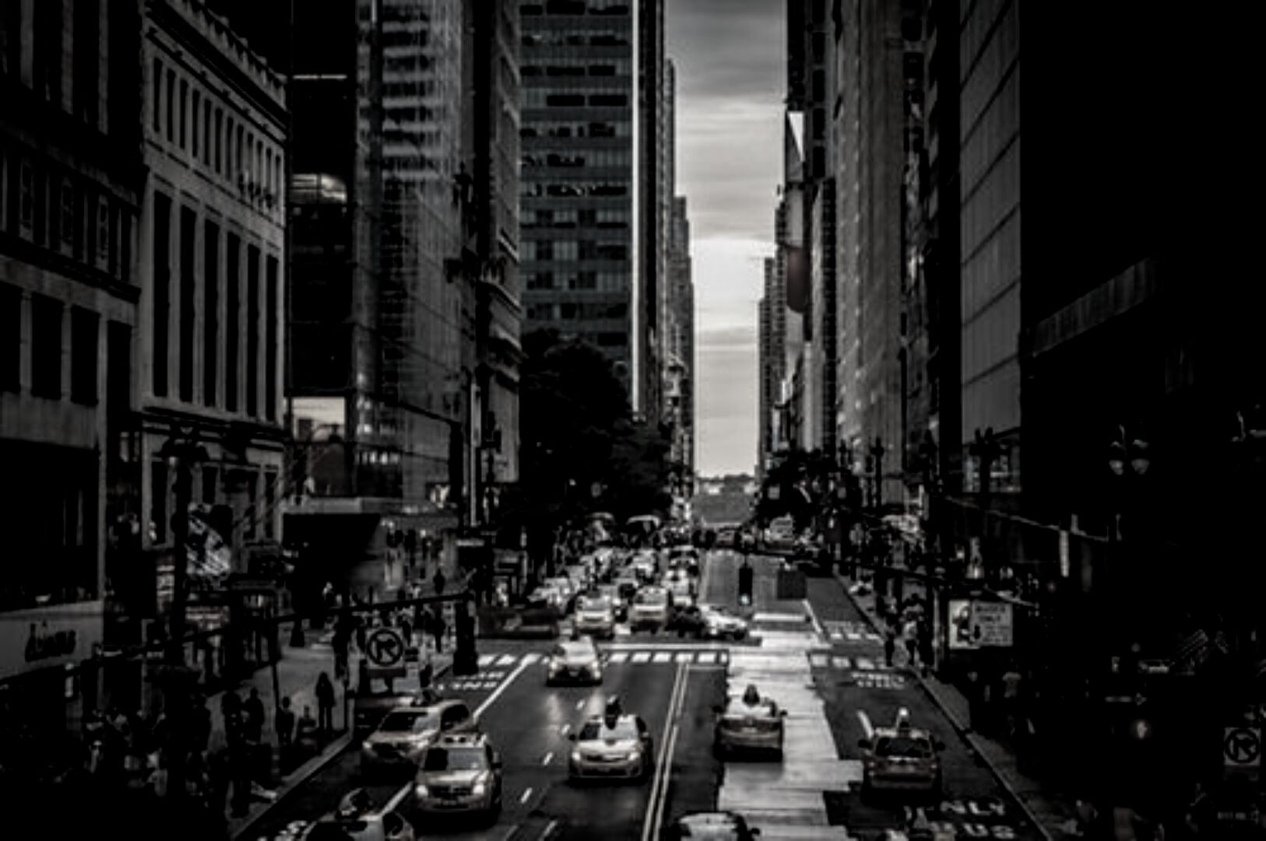
Age Demographics
Age in years, 2019
984 Driving-Age Individuals
300
200
100
0
16-17
18-34
35-49
50-64
65+

Slide 8
Gender Demographics
984 Driving-Age Individuals, 2019
Identifies as woman
50%
Identifies as man
49%
Identifies in some other way
1%

Slide 9
Educational Demographics
High School
Educational Level Reached, 2019
984 Driving-Age Individuals
Some College
Associate's/Bachelor's
Master's or Higher
0%
10%
20%
30%
40%
50%

Slide 10
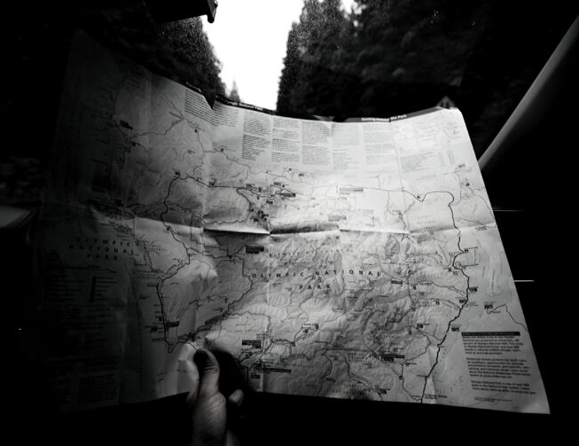
Rural
8%
Geographic Demographics
Urban
41%
984 Driving-Age Individuals, 2019
Suburban
51%

Slide 11
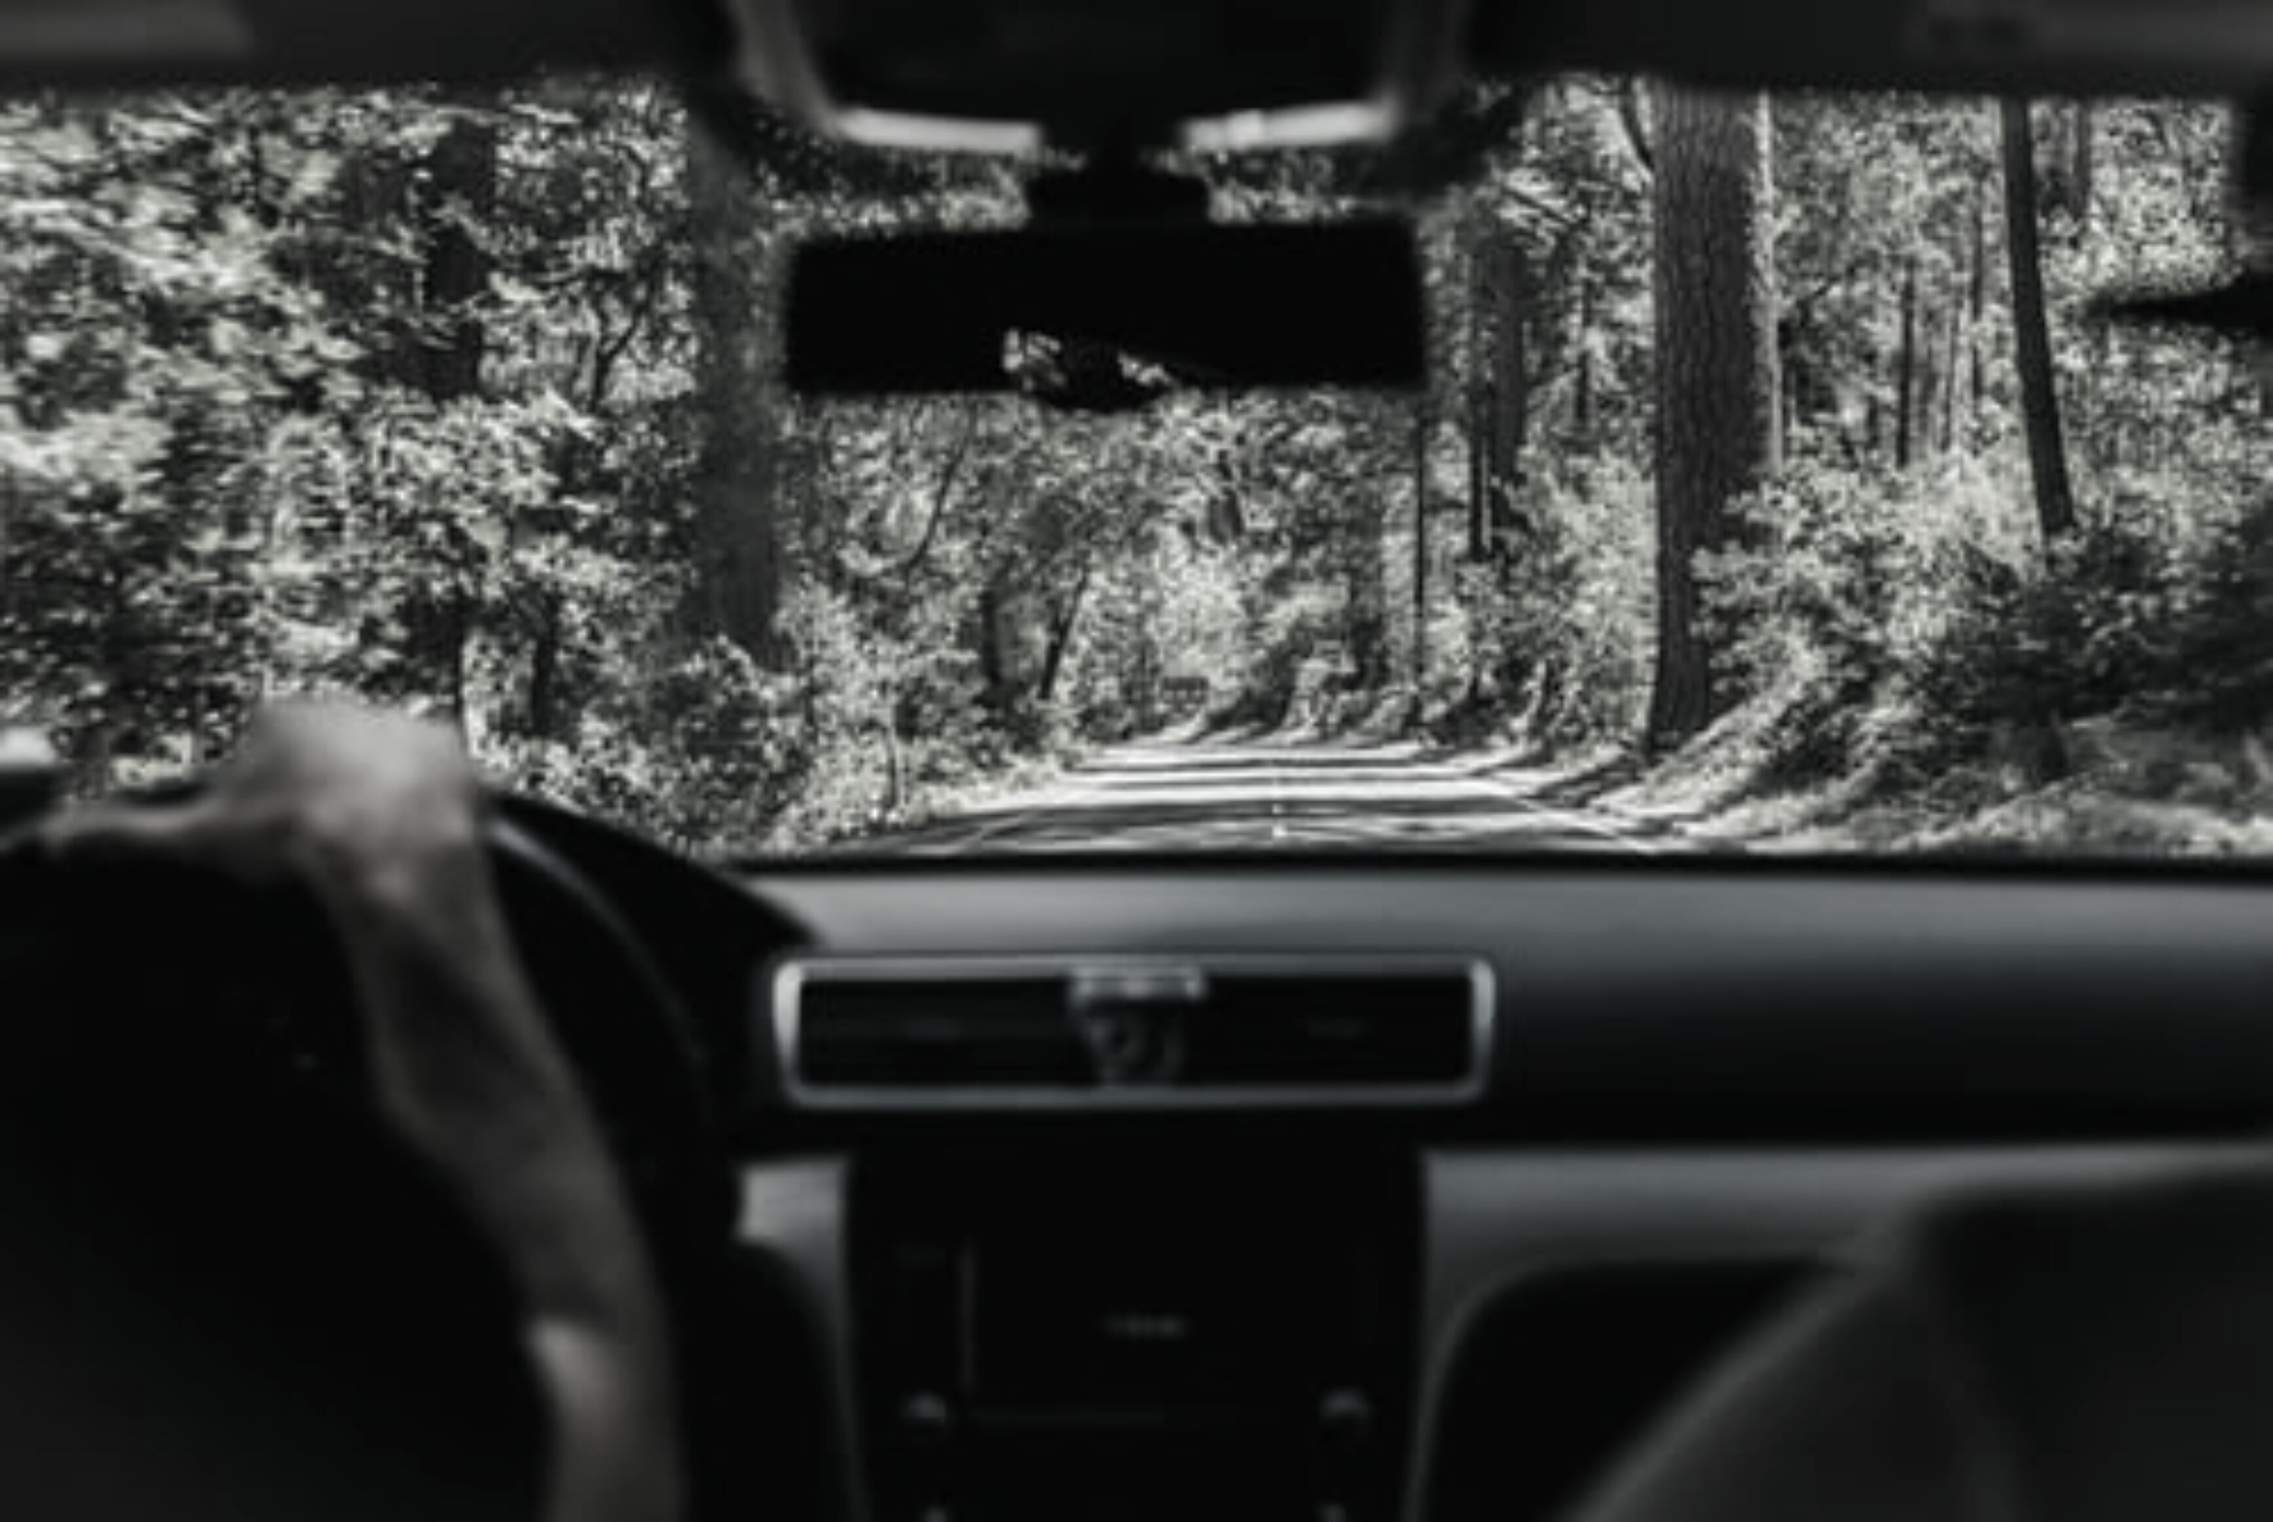
300
Income Demographics
200
Total Annual Income from
Everyone in Household, 2019
984 Driving-Age Individuals
100
0
< $40K
$40-80K
$80-120K
> $160K
$120-160K

Slide 12
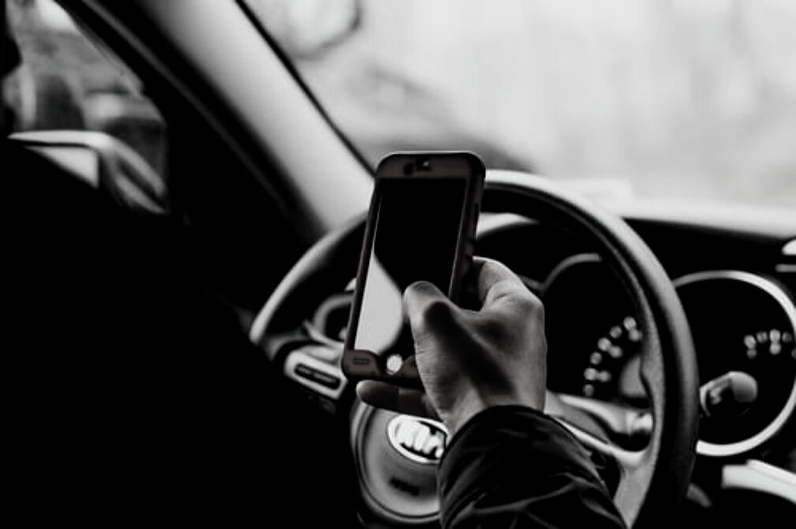
No
16.2%
Driving
Driven a motor vehicle in the past 30 days, 2019
984 Driving-Age Individuals
Yes
83.8%

Slide 13
KEY TAKEAWAYS
2018-2019

Slide 14
DRIVING UNDER THE INFLUENCE
92% perceive others driving after drinking to be a "very serious threat"
Only 62% perceive others driving after use of marijuana to be a "very serious threat"
Overall Population Findings:
Perceptions
DRIVING WHILE DROWSY
94% perceive others driving while falling asleep to be a "very serious threat"
DRIVING AGGRESSIVELY
71% perceive others driving aggressively as a "very serious threat"

Slide 15
PERCEPTIONS ON HAND-HELD PHONE USAGE
70% PERCEIVE IT TO BE A "VERY SERIOUS THREAT" IF OTHER DRIVERS TEXT OR EMAIL WHILE DRIVING
56% SAY IT IS "COMPLETELY UNACCEPTABLE" TO READ A TEXT OR EMAIL WHILE DRIVING
43% SAY IT IS "COMPLETELY UNACCEPTABLE" TO TALK ON A HAND-HELD PHONE WHILE DRIVING
69% SAY IT IS "COMPLETELY UNACCEPTABLE" TO TYPE A TEXT
MESSAGE WHILE DRIVING
69% SAY IT IS "COMPLETELY UNACCEPTABLE" TO TYPE A TEXT OR EMAIL WHILE DRIVING
42% SAY IT IS "COMPLETELY UNACCEPTABLE" TO USE A PHONE APP OTHER THAN GPS WHILE DRIVING

Slide 16
BEHAVIORS WITH HAND-HELD PHONE USAGE
20% SAY, IN THE PAST 30 DAYS, THEY "REGULARLY" OR "FAIRLY OFTEN" READ TEXTS OR EMAILS WHILE DRIVING
53% SAY, IN THE PAST 30 DAYS,
THEY "NEVER" READ A TEXT MESSAGE WHILE DRIVING
14% SAY THEY "REGULARLY" OR "FAIRLY OFTEN" TALK ON A HAND-HELD PHONE WHILE DRIVING
65% SAY, IN THE PAST 30 DAYS,
THEY "NEVER" TYPED A TEXT MESSAGE WHILE DRIVING
11% SAY THEY "REGULARLY"
OR "FAIRLY OFTEN" TYPED TEXTS
OR EMAILS WHILE DRIVING
18% SAY THEY "REGULARLY" OR "FAIRLY OFTEN" USED A PHONE APP OTHER THAN GPS WHILE DRIVING

Slide 17
PREDICTING FUTURE BEHAVIORS
WITH HAND-HELD PHONE USAGE:
IN THE NEXT 30 DAYS...
85% SAY THEY ARE "UNLIKELY" OR "VERY UNLIKELY" TO TALK ON A HAND-HELD PHONE WHILE DRIVING
90% SAY THEY ARE "UNLIKELY" OR "VERY UNLIKELY" TO TYPE A TEXT MESSAGE WHILE DRIVING
79% SAY THEY ARE "UNLIKELY" OR "VERY UNLIKELY" TO USE A PHONE APP OTHER THAN GPS WHILE DRIVING

Slide 18
TYPING A TEXT MESSAGE
FINDINGS THAT SUGGEST EXISTING CONFUSION AROUND OUR LAWS
68% correctly say it is "illegal" to type a text message while stopped at an intersection
USING PHONE CAMERA
53% correctly say it is "illegal" to use your cell-phone camera while stopped at an intersection
Urban: 47%
HAND-HELD PHONE USE
44% were not sure or incorrectly said it is "illegal" to call 911
71% correctly say it is "illegal" to use a hand-held cell phone while stopped at an intersection
Women: 71%
Urban: 68%

Slide 19
WHAT WOULD IT TAKE FOR A PERSON TO
STOP USING A CELL PHONE WHILE DRIVING?
38%
IN KING COUNTY WOULD NOT STOP EVEN IF IT CAUSED THEM TO STRIKE & KILL SOMEONE WITH THEIR VEHICLE
52%
OF ASIAN AMERICANS IN KING COUNTY WOULD STOP USING THEIR CELL PHONE AFTER A FATALITY
61%
OF WOMEN IN KING COUNTY WOULD STOP USING THEIR CELL PHONE AFTER A FATALITY
63%
OF MEN IN KING COUNTY WOULD STOP USING THEIR CELL PHONE AFTER A FATALITY

Slide 20
EXPECTING A TRAFFIC TICKET
8% perceive it to be "likely" or "very likely" for them to get a traffic ticket for texting while driving
Traffic Tickets
TICKETS THAT WOULD STOP DRIVERS FROM USING PHONE WHILE DRIVING
51% would stop at ticket cost of $124
59% would stop at ticket cost of $240+
56% would stop if ticket reported to insurance

Slide 21
OUT OF 984 RESPONDENTS, 138 (14%) "REGULARLY"
OR "FAIRLY OFTEN" TALKED ON HAND-HELD PHONES.
AMONG THE 138 (14%) WHO "REGULARLY" OR "FAIRLY OFTEN" TALKED ON A HAND-HELD PHONE WHILE DRIVING:
51%
SAID IT WAS "COMPLETELY ACCEPTABLE" OR "ACCEPTABLE" TO TALK ON HAND-HELD WHILE DRIVING
62%
SAID TALKING ON HAND-HELD WHILE DRIVING WAS A "THREAT" OR "VERY SERIOUS THREAT"
60%
SAID THEY WILL "VERY LIKELY" OR "LIKELY" TALK ON HAND-HELD WHILE DRIVING IN THE NEXT 30 DAYS
26%
SAID IT'S "VERY LIKELY" OR "LIKELY" FOR THEM TO GET A TICKET FOR TALKING ON HAND-HELD WHILE DRIVING
19%
SAID IT'S "VERY LIKELY" OR "LIKELY" FOR THEM TO CRASH WHILE TALKING ON A HAND-HELD

Slide 22
OUT OF 984 RESPONDENTS, 196 (20%) "REGULARLY"
OR "FAIRLY OFTEN" READ TEXTS WHILE DRIVING.
AMONG THE 196 (20%) WHO "REGULARLY" OR "FAIRLY OFTEN" READ TEXTS WHILE DRIVING:
24%
SAID IT WAS "COMPLETELY ACCEPTABLE" OR "ACCEPTABLE" TO READ A TEXT/EMAIL WHILE DRIVING
92%
SAID TEXTING OR EMAILING WHILE DRIVING WAS A "THREAT" OR "VERY SERIOUS THREAT"
24%
SAID IT'S "VERY LIKELY" OR "LIKELY" FOR THEM TO GET A TICKET FOR TEXTING WHILE DRIVING
24%
SAID IT'S "VERY LIKELY" OR "LIKELY" FOR THEM TO CRASH WHILE TEXTING AND DRIVING

Slide 23
OUT OF 984 RESPONDENTS, 123 (13%) "REGULARLY"
OR "FAIRLY OFTEN" TYPED WHILE DRIVING.
AMONG THE 123 (13%) WHO "REGULARLY" OR "FAIRLY OFTEN" TYPED WHILE DRIVING:
23%
SAID IT WAS "COMPLETELY ACCEPTABLE" OR "ACCEPTABLE" TO TYPE A TEXT/EMAIL WHILE DRIVING
86%
SAID TEXTING OR EMAILING WHILE DRIVING WAS A "THREAT" OR "VERY SERIOUS THREAT"
51%
SAID IT'S "VERY LIKELY" OR "LIKELY" FOR THEM TO TYPE A TEXT WHILE DRIVING IN THE NEXT 30 DAYS
33%
SAID IT'S "VERY LIKELY" OR "LIKELY" FOR THEM TO GET A TICKET FOR TEXTING WHILE DRIVING
33%
SAID IT'S "VERY LIKELY" OR "LIKELY" FOR THEM TO CRASH WHILE TEXTING AND DRIVING

Slide 24
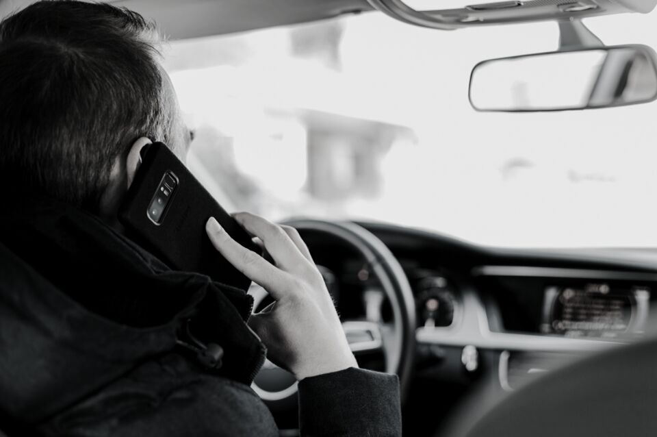
WHO IS PRIMARILY TALKING ON A CELL PHONE WHILE DRIVING?
16% of male respondents said...
it was "likely" or "very likely" they would talk on a hand-held phone while driving
77% of under age 18 "very unlikely"
to talk on hand-held phone while driving
In comparison, only 57% "very unlikely"
to talk on hand-held phone while
driving among both respondents
ages 18-34 and respondents ages 34-49

Slide 25
Hispanic Subpopulation: Data Improvements
21 data points where King County Hispanics are either:
More regularly obeying the law
More fearful of disobeying the law
Have a newfound appreciation for how using a cell phone while driving may be perceived by other drivers
2018-2019

Slide 26
Hispanic Subpopulation, 2018 to 2019
POSITIVE PERCEPTIONS AND BELIEFS
WHILE STOPPED AT INTERSECTION
PERCEPTION OF LIKELIHOOD OF ________
Percentage of Hispanics who
correctly say it is illegal, while
stopped at an intersection, to:
use a hand-held cell phone...53% to 65%
use phone camera.......................43% to 51%
read a text message...................41% to 58%
Percentage of Hispanics who say they're:
"likely" to talk on phone: 28% to 16%
"likely" to get ticket for using phone: 2% to 8%
"very likely" to type text: 11% to 2%
"very unlikely" to get ticket for texting: 82% to 67%
"very likely" to crash car while using phone: 0% to 7%
"likely" or "very likely" to crash while texting: 3% to 11%
"COMPLETELY UNACCEPTABLE" TO
TALK ON PHONE WHILE DRIVING
Reported belief that it is
"completely unacceptable"
to talk on hand-held
phone while driving............................26% to 44%

Slide 27
HISPANIC SUBPOPULATION
POSITIVE MOTIVATIONS
REPORTED WILLINGNESS TO STOP USING
THEIR PHONE WHILE DRIVING IF:
a family member asked them to stop:
40% to 55%
a passenger asked them to stop:
35% to 49%
the traffic ticket for being caught cost $240:
38% to 49%
they crashed their car due to phone use:
51% to 63%
they killed someone due to phone use while driving:
53% to 62%

Slide 28
Hispanic Subpopulation, 2018 to 2019
POSITIVE BEHAVIORS
NOT TEXTING
WHILE DRIVING
NOT HOLDING PHONE
WHILE ON SPEAKER
Percentage of Hispanics who:
read texts "regularly" dropped from 31% to 11%
type texts "regularly" dropped from 20% to 3%
Percentage of Hispanics who correctly say it is illegal, while driving, to hold a cell phone
while using the phone's speaker increased from 49% to 61%

Slide 29
The King County Target Zero Task
Force will repeat
this survey next year.
TO TAKE A LOOK AT THE DATA OR ANALYSIS:
http://www.surveyusa.com/client/PollReport.aspx?g=b92f51f2-97c2-4b24-872c-16f8695d26de
https://www.surveyusa.net/wp-content/uploads/2019/05/SurveyUSA-24796-Analysis-Report.pdf

Slide 30
Thank you

