Slide 1
This conversation might save your life. (bold, I know)

Slide 2
Hello!
I’m Taylor Parker
I’m here because I care about traffic safety.
Here’s how you can reach me:
taylorparker@email.com
(123) 456-7890
Notes:
Hi, I’m Taylor Parker. I’m a Target Zero Manager for the Washington Traffic Safety Commission. I’ll explain what that is in a bit.

Slide 3
We never drive alone.
Why traffic safety matters, and what we can do about it
Notes:
Our roads are a space we share with everyone in our community. Of all the things we routinely do, driving is the biggest risk we take. How we think about driving, and the behaviors we engage in, can shift our risk much lower (or higher). There’s a lot we can do across the state, in our communities, and as individuals to make travel safer for all of us.

Slide 4
We never drive alone.
Notes:
I’m going to show you a short traffic safety PSA, and be thinking, are the values expressed in the video similar to mine? If not, what are the differences?

Slide 5
What do you think?
Notes:
As you engage in discussion, let people know it’s okay if they don’t fully agree with the message. We’re here to have a conversation and learn from each other.

Slide 6
Can our small actions really make a difference?
Do I agree with the overall message?
If I were creating the message, what would I say to drivers?
Do my neighbors agree with it?
Notes:
As you engage in discussion, let people know it’s okay if they don’t fully agree with the message. We’re here to have a conversation and learn from each other.

Slide 7
The driving situation
What’s happening in Washington and in [City/County]
Notes:
Before we get to what we can do, we should know our current driving situation, so let’s look at some important data. And if you’re not a data person, that’s okay, this is just a snapshot to help understand some factors of serious crashes in our state and our community.

Slide 8
Traffic Safety Behaviors in Washington
Most Washington drivers don’t engage in high-risk traffic behaviors.
Notes:
First, it’s good to note that most of us aren’t engaged in risky driving behaviors most of the time.
In case you’re curious, I’ll point out that the data on driving impaired represents drivers that never drove within two hours of consuming alcohol or cannabis within the past year. The seat belt and distraction data comes from observational surveys where observers look at passing drivers and note the ones who are distracted or not wearing a seat belt. The comparisons are not equal; the impairment data is over the course of a year, while the seat belt data is a moment in time. If we had the ability to do observational surveys of impaired drivers, you’d see much higher safe driving behaviors. For example, a 2014 roadside study in Washington found that 95 percent of drivers had a blood alcohol level of zero.*
Sources:
Alcohol and cannabis: Driving Under the Influence of Cannabis and Alcohol Key Findings Report from 2018 Survey – Montana State University Center for Health and Safety Culture (Survey of Washington Drivers) – Data is for drivers that never drove within two hours of consuming alcohol or cannabis within the past year
Seat belt: 2022 Seat Belt Use Observation Survey – Washington Traffic Safety Commission
Distraction: 2022 Distracted Driving Observation Survey – Washington Traffic Safety Commission
*https://www.nhtsa.gov/sites/nhtsa.gov/files/812299-washingtonstatedrugstudy.pdf

Slide 9
Statewide Traffic Fatalities
Notes:
And if someone leads with good news, you can bet there’s some bad news too. In spite most of us doing the right thing most of the time, we still have too many serious crashes. Those high-risk behaviors have disproportionate consequences.
Data for this chart comes from the WTSC fatalities dashboard: https://wtsc.wa.gov/research-data/fatalities-dashboard/

Slide 10
[County/City] Traffic Fatalities
Notes:
And this is what we’ve experienced locally.
Data for this chart comes from the WTSC fatalities dashboard: https://wtsc.wa.gov/research-data/fatalities-dashboard/
For smaller cities, you may not have sufficient fatal crash data to show any trends. For this chart, consider using either total crashes in your city, or county-wide traffic fatality data.
For total crashes, use the WSDOT Crash Data Portal: https://remoteapps.wsdot.wa.gov/highwaysafety/collision/data/portal/public/ Select “Summary Rports” and “10 Year Crash Summary”

Slide 11
Fatalities Involving High Risk Factors
Washington
Notes:
Data from WTSC Crash Data Dashboards - https://wtsc.wa.gov/research-data/dashboards/

Slide 12
Fatalities Involving High Risk Factors
County/City
Notes:
Data from WTSC Crash Data Dashboards - https://wtsc.wa.gov/research-data/dashboards/

Slide 13
Fatalities Involving High Risk Factors
Washington
Notes:
Note: This version separates impaired into alcohol and drugs and doesn’t include unrestrained drivers – I’d generally use the other version unless your presentation is focused on impairment
Data from WTSC Crash Data Dashboards - https://wtsc.wa.gov/research-data/dashboards/

Slide 14
Fatalities Involving High Risk Factors
County/City
Notes:
Note: This version separates impaired into alcohol and drugs and doesn’t include unrestrained drivers – I’d generally use the other version unless your presentation is focused on impairment
Data from WTSC Crash Data Dashboards - https://wtsc.wa.gov/research-data/dashboards/

Slide 15
Fatalities – Road Users
Washington
Notes:
Data for this chart comes from the WTSC fatalities dashboard: https://wtsc.wa.gov/research-data/fatalities-dashboard/

Slide 16
Fatalities – Road Users
County/City
Notes:
Data for this chart comes from the WTSC fatalities dashboard: https://wtsc.wa.gov/research-data/fatalities-dashboard/
For smaller cities, use county-wide data.

Slide 17
Fatal Crashes - Locations
Notes:
Data for this slide comes from the WTSC fatal crash map dashboard: https://wtsc.wa.gov/research-data/fatal-crash-map/
Smaller cities may want to use the following alternate slide, showing all crashes.

Slide 18
All Crashes - 2022
Notes:
This data comes from the WSDOT Crash Data Portal: https://remoteapps.wsdot.wa.gov/highwaysafety/collision/data/portal/public/
Select “Summary Reports”, “Total Crashes”, the report year and the location.
As you can see, in larger cities there are so many crashes that the data is overwhelming to the point of not being very useful. In this case, consider showing only injury and fatal crashes.

Slide 19
Driving Perceptions
Notes:
Our perceptions influence how we drive. For example, if you underestimate the risk of speeding or believe that you won’t be caught if you do, you might be more inclined to speed. If you understand how dangerous it is to drive impaired, you, like almost all of us, will never drive impaired.
So let’s take a look at our perceptions about other drivers and how dangerous some behaviors are, attitudes about enforcement and intervention, along with employer and family rules.
We’ll start with our perceptions of others. Even if you generally think the best of people, you probably tend to think other drivers are worse than they really are. Or at least worse than you are. The Washington Traffic Safety Commission surveyed thousands of people, and here’s collectively what we think.

Slide 20
Driving Perceptions – Seat Belts
How often do most people in your community wear a seat belt?
How often do you wear a seat belt?
Notes:
Data from statewide survey

Slide 21
Driving Perceptions – Speeding
How often do most people in your community drive 10 mph or more over the speed limit?
How often do you drive 10 mph or more over the speed limit?
Notes:
Data from statewide survey

Slide 22
Driving Perceptions – Cell Phones
How often do most people in your community drive while holding and talking on a phone?
How often do you drive while holding and talking on a phone?
Notes:
Data from statewide survey

Slide 23
Driving Perceptions – Impairment
How often do most people in your community drive after consuming alcohol?
In the past year, have you driven a vehicle while under the influence of alcohol?
Notes:
Data from statewide survey

Slide 24
Driving Perceptions – Danger
How dangerous do you feel the following driving behaviors are . . .
Notes:
We mostly agree on high-risk driving behaviors. But lots of people don’t perceive speeding to be as dangerous as some other behaviors. However, as we saw earlier, speeding is a factor in about a third of all traffic fatalities. And statewide observation surveys find that drivers speed far more frequently than they drive distracted.
Data from statewide survey

Slide 25
Driving Perceptions – Enforcement
How much do you support or opposed law enforcement enforcing . . .
Notes:
Here again, we have the lowest support for speeding – likely because many drivers don’t perceive it to be as dangerous as other behaviors.
Data from statewide survey

Slide 26
Driving Perceptions – Intervention
How comfortable would it be for you to . . .
Notes:
Data from statewide survey

Slide 27
Employer Policies
Does your employer have a policy about . . .
Notes:
Data from statewide survey

Slide 28
Family Rules
Does your family have a rule about . . .
Notes:
Data from statewide survey

Slide 29
We should do something!
Notes:
Hopefully, at this point you agree. We should do something. I wouldn’t be here talking with you today if I didn’t believe that this can change. I’m going to start by spending a few minutes on the big picture: What the Washington Traffic Safety Commission is doing at the state and local level to reduce serious injury and fatal crashes. Then we’re going to spend most of our time exploring ways that we all can make a difference in our community.

Slide 30
Mission: Empower and equip people and communities with knowledge, tools, and resources to build a positive traffic safety culture.
Notes:
The Washington Traffic Safety Commission agrees with you. In fact, the whole purpose of the WTSC is increasing traffic safety for all road users.

Slide 31
Notes:
First, we need a plan, right? Washington has a Strategic Highway Safety Plan, what we call our Target Zero Plan.
You might already be familiar with Target Zero, but I don’t want to make any assumptions. Target Zero is our state’s goal of eliminating serious injury and fatal crashes. Yes, it’s aspirational. It’s also the only reasonable goal. For anyone who suggests that we should set a goal that’s easier to achieve, like reducing fatalities by some percentage, ask yourself, what percentage of my family and friends am I willing to give up to traffic crashes? It has to be zero.
And, some days we’re achieving it. Example: Last year there were no fatal crashes in [county/city] for the entire month of [month]. We can do it for days, weeks, even a month; we want to aim for all year.
Our Target Zero plan identifies the various contributing factors in fatal crashes, and lays out strategies to address those risk factors. We look at the issues through a Safe System approach.

Slide 32
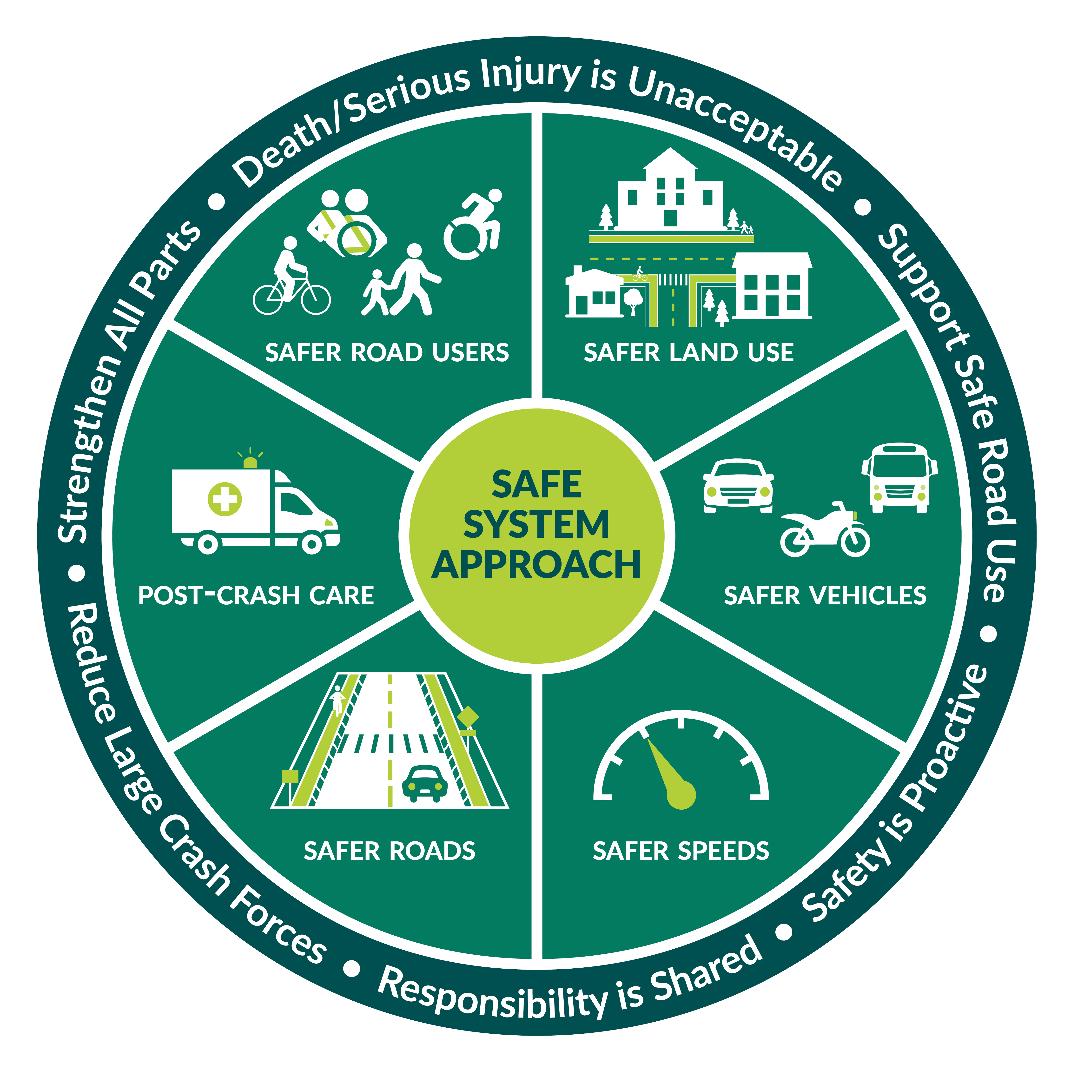
Safe System Approach
Notes:
Traffic safety isn’t the responsibility of one organization, and it isn’t solved with a single strategy. We use a safe system approach because humans make mistakes. And we’re vulnerable. So we need to share responsibility with everyone that has a stake in our road system, from the road designer to the road user.
Law enforcement, traffic engineers, vehicle designers, emergency responders, community leaders, and all of us play a part in traffic safety.

Slide 33
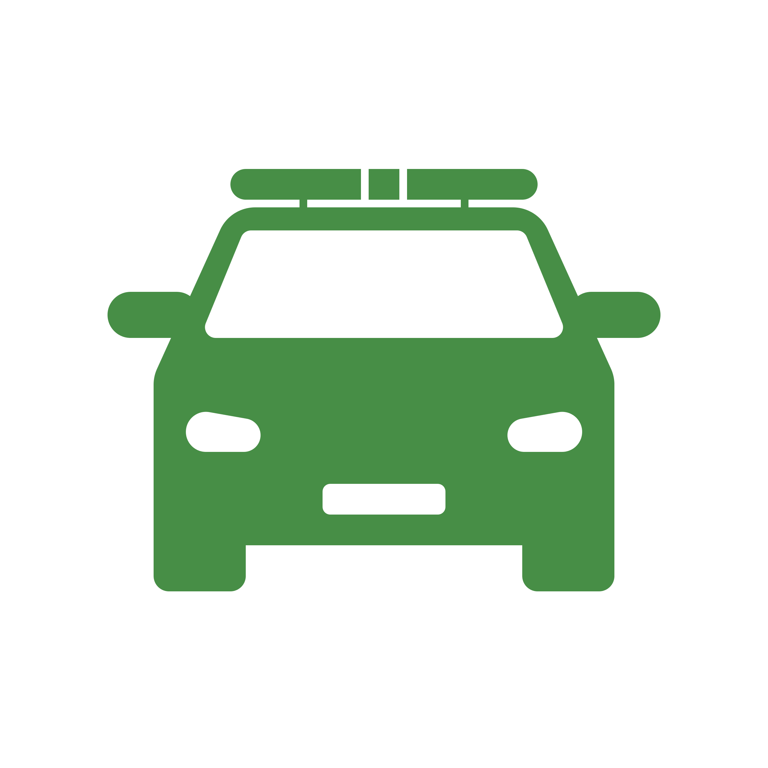
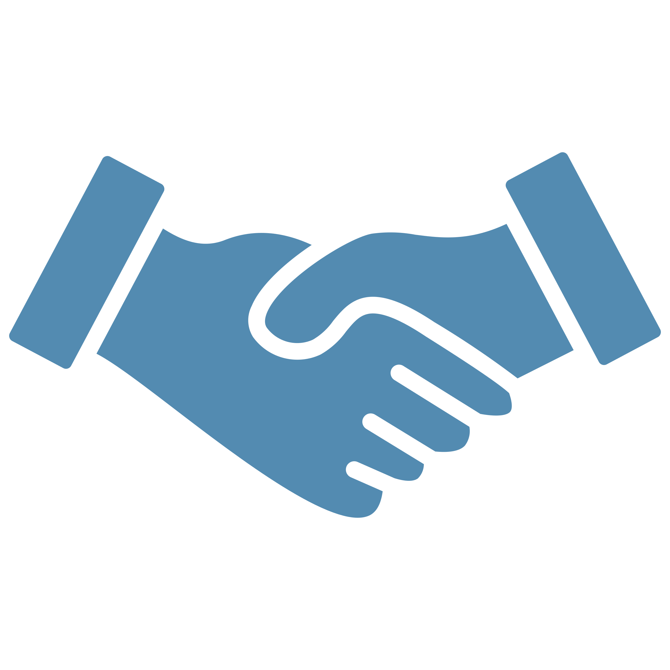
Target Zero Managers
High Visibility Enforcement
Young Driver Programs
Coordinating Law Enforcement Training
Traffic Safety Education
Identifying and Responding to Local Trends
Collaboration with Local Partners
Notes:
When I introduced myself, I said that I’m a Target Zero Manager. I’m one of 18 TZMs around the state. Our role is the coordination of traffic safety efforts at the local level. What does that mean?
Things like high visibility enforcement patrols focusing on top risk factors – impairment, distraction, speed, seat belts
Local projects like Teen Target Zero and Teens in the Driver’s Seat, both young driver education programs, traffic gardens where young children can learn about navigating roads in a safe environment
Coordinating law enforcement training
Traffic safety education
Identifying and responding to local trends
Here in [region], we’re [talk about what you’re doing]
To be clear, that’s not me as a TZM doing all of that. It’s a community effort. I work with [list partners] ie. Law enforcement, schools, pedestrian safety groups, traffic engineers, CPS team, etc.

Slide 34
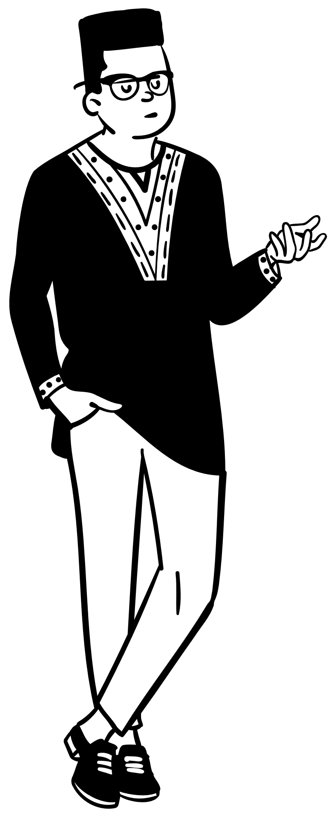
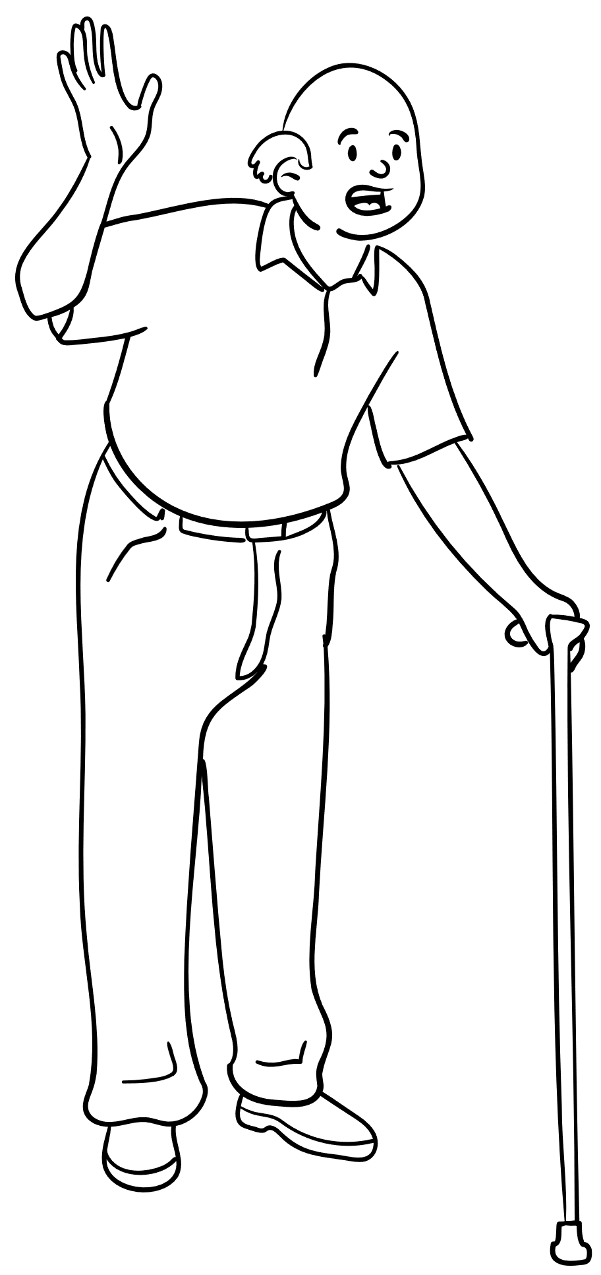
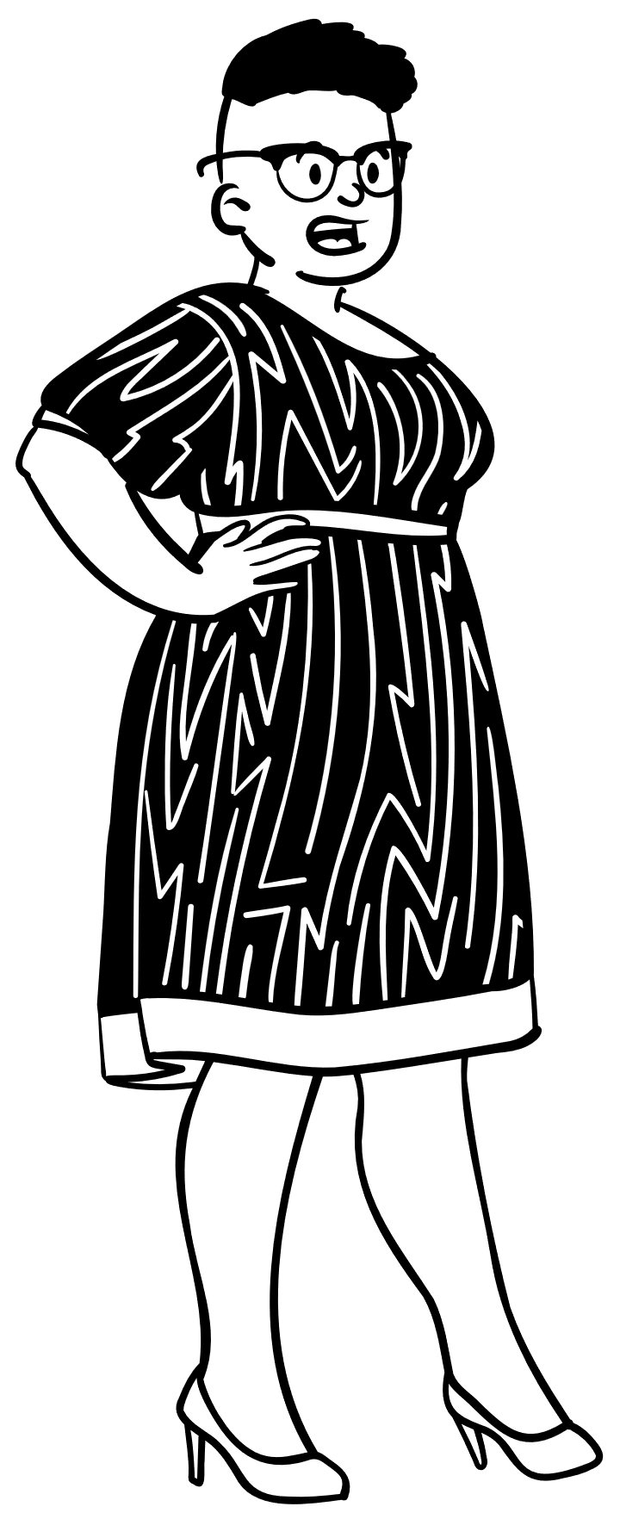
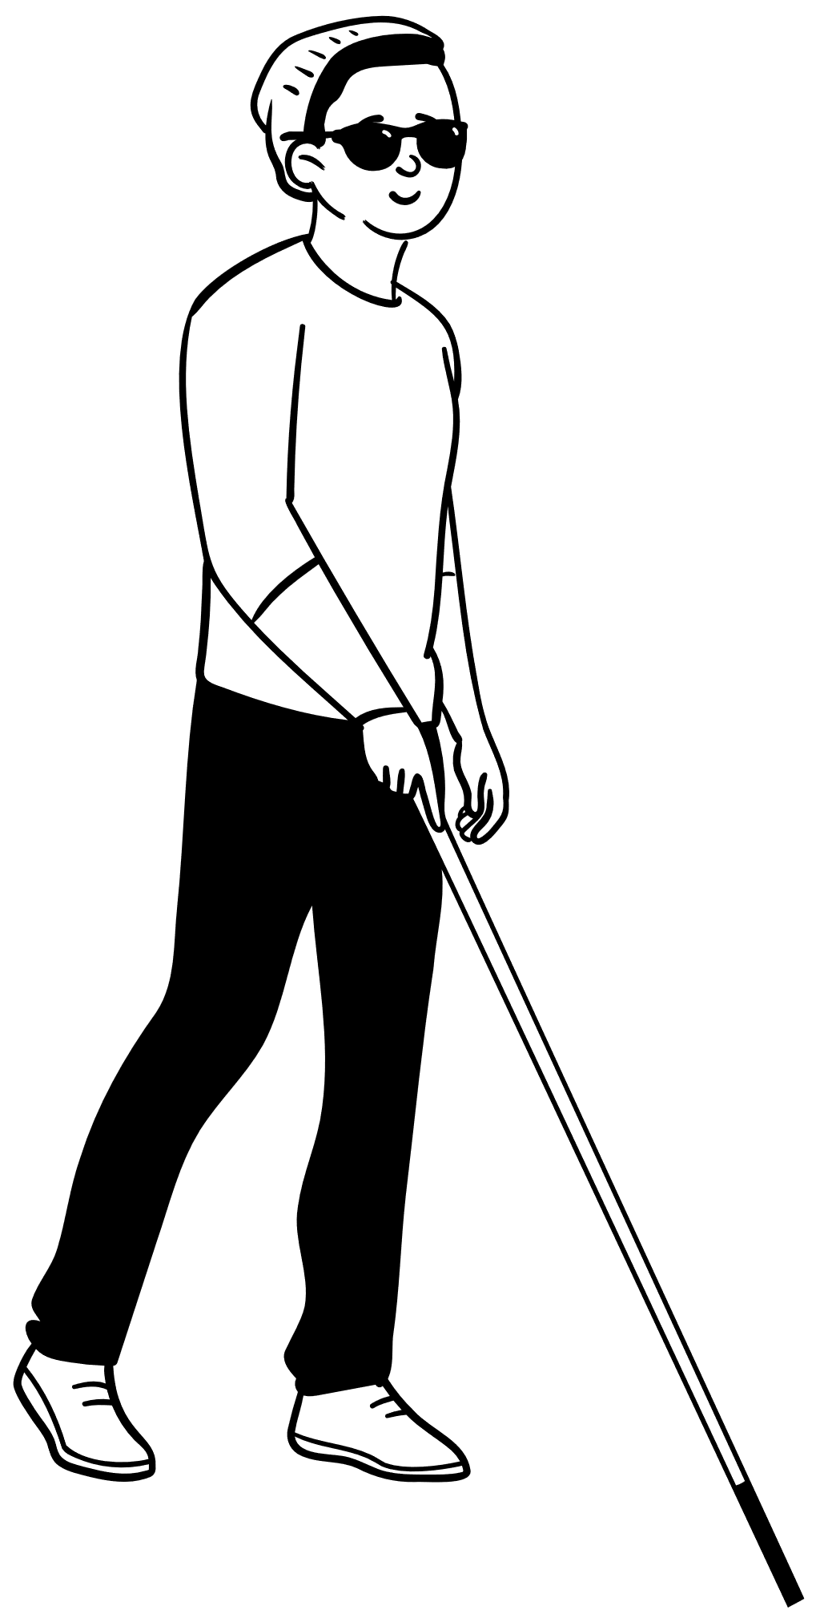
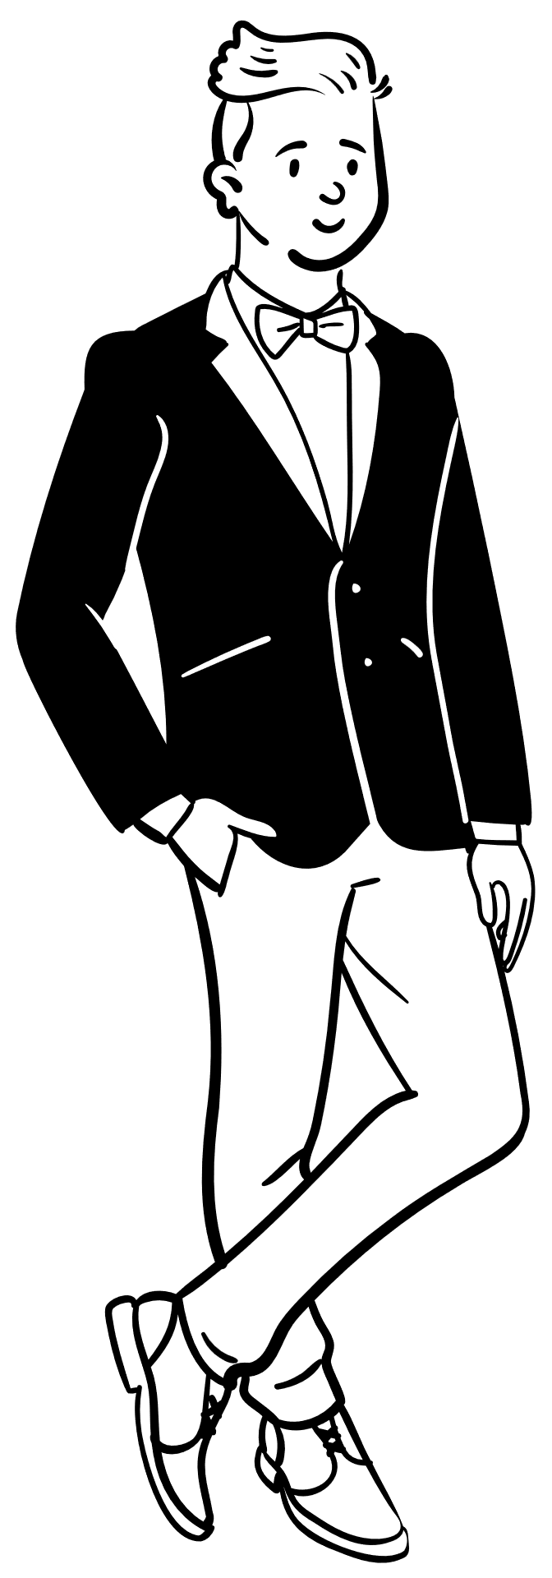
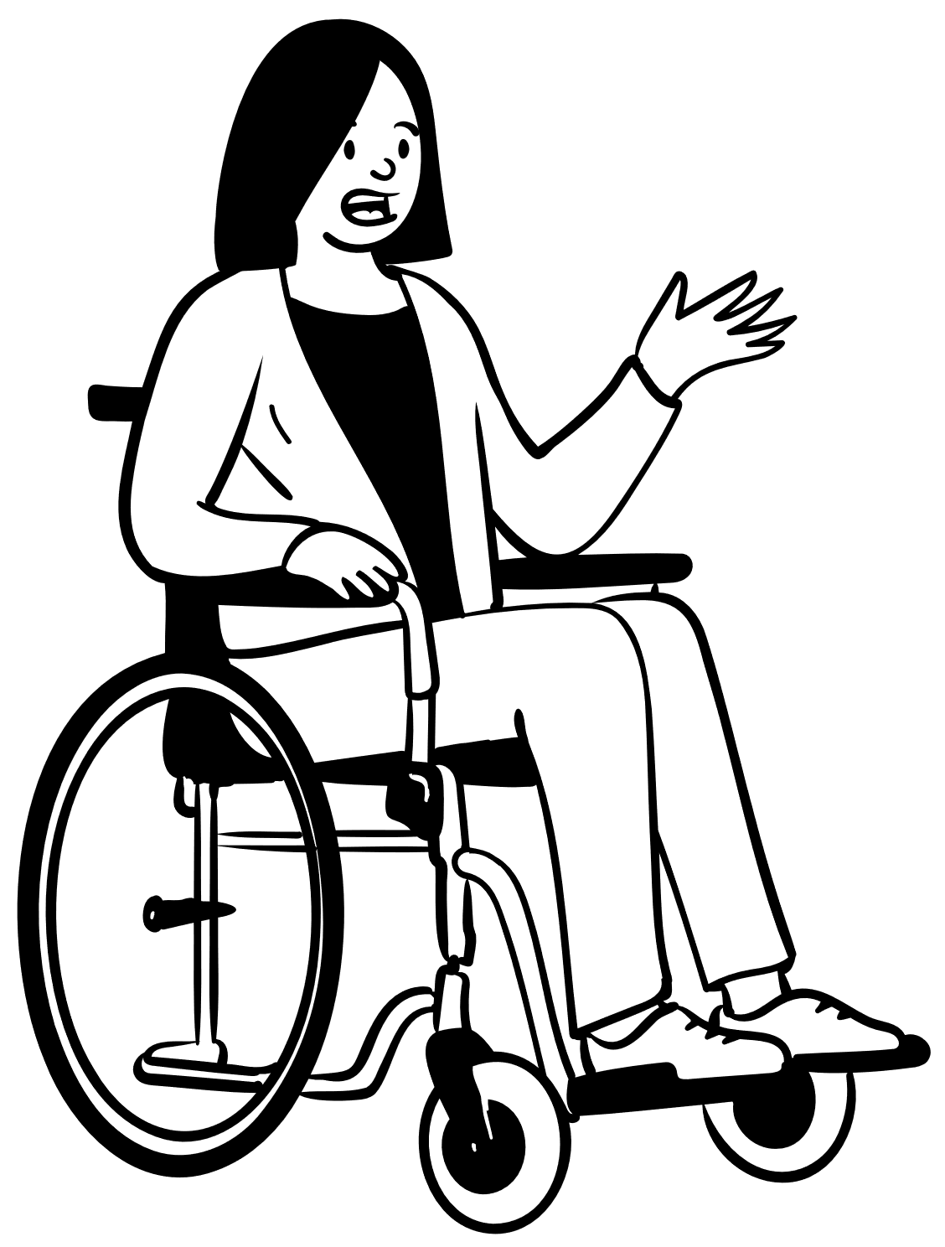
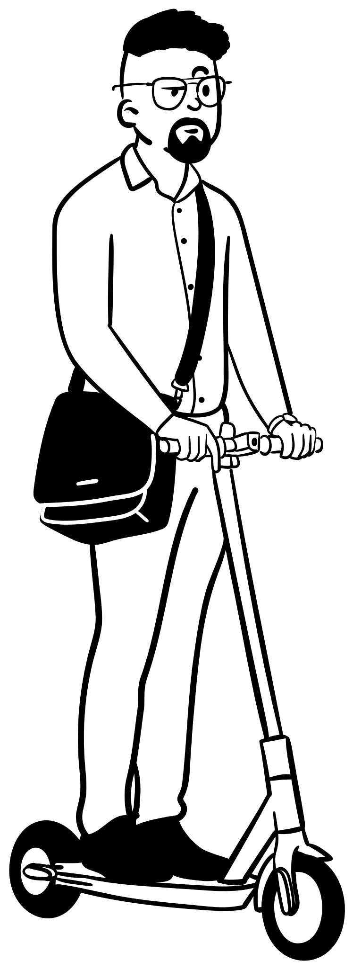
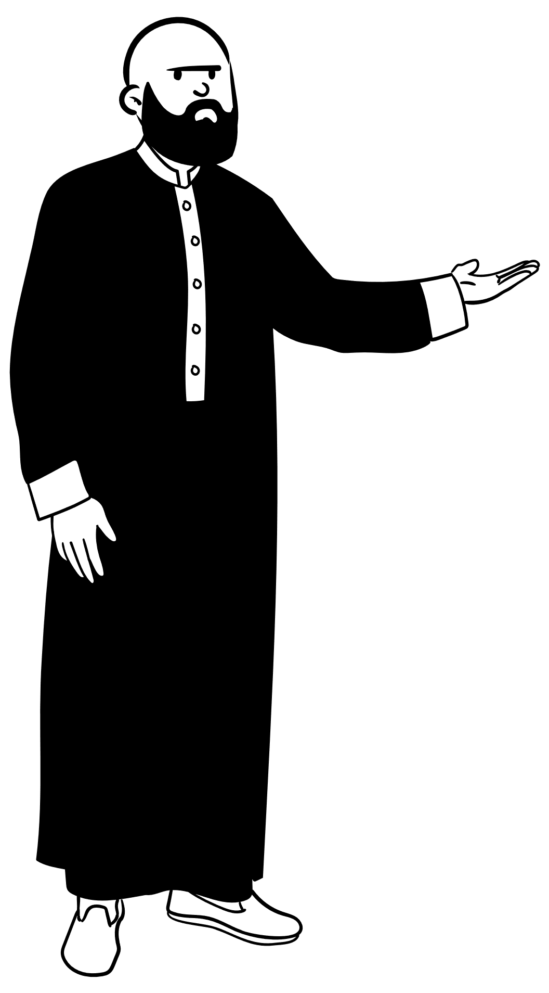
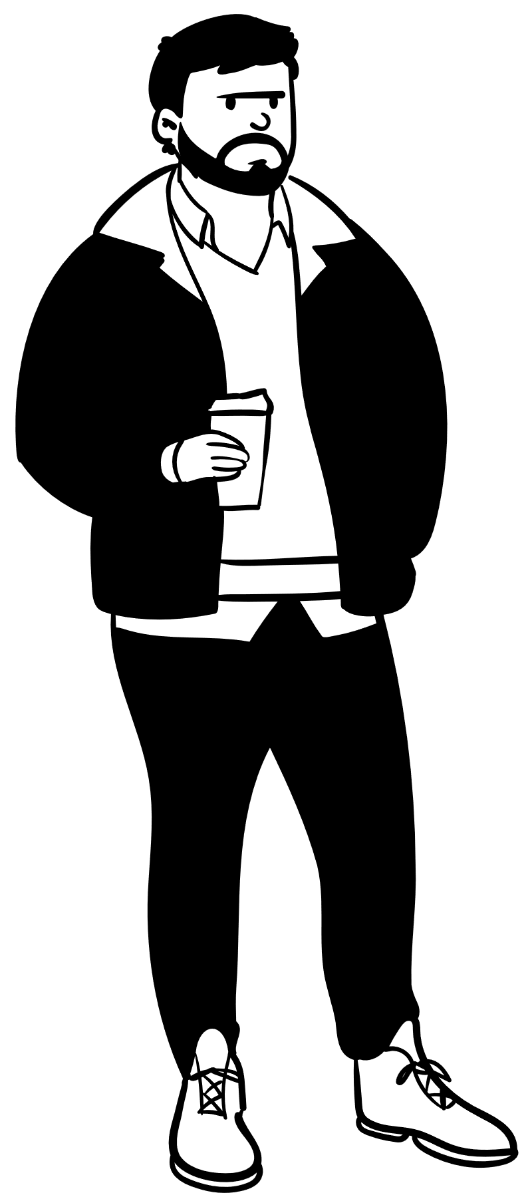
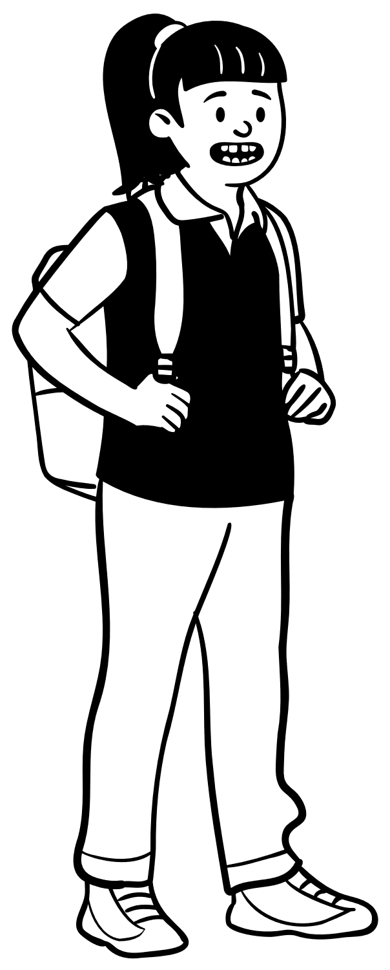
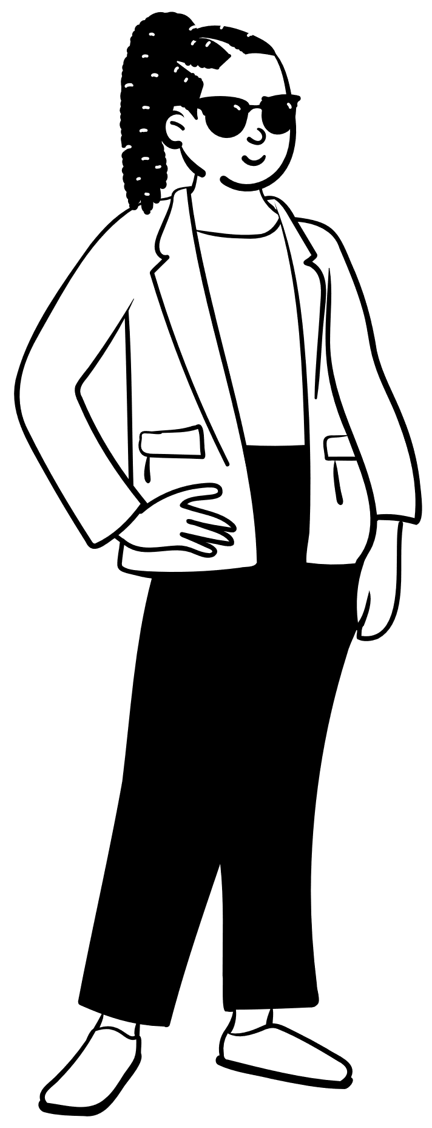
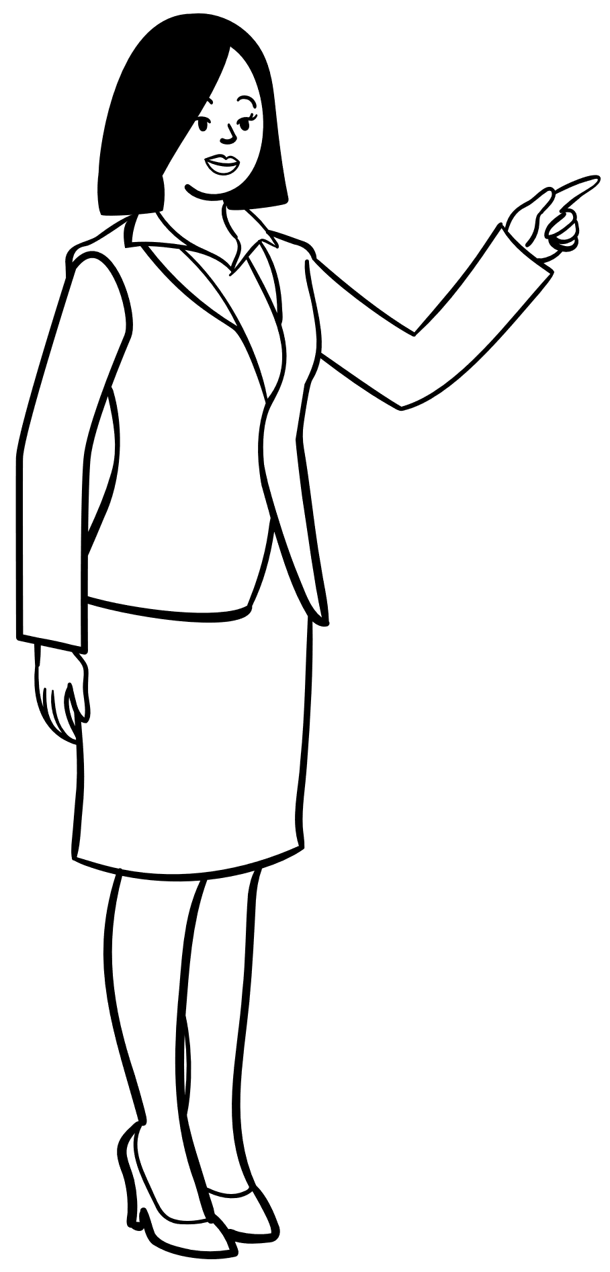
We Can’t Do it Without You
Notes:
I’m telling you about all these different organizations partly to affirm that traffic safety is a collaborative effort. Let’s face it:
On their own,
The police won’t end crashes by writing enough tickets.
Traffic engineers won’t end crashes by designing better roads.
Car companies won’t end crashes by building safer cars.
The WTSC won’t end crashes by crafting the perfect safety message.
But, collectively, all of those efforts are proven to make a difference.
So let’s look at some ways that we can make a difference in our community.

Slide 35
We Can’t Do it Without You
Notes:
I’m telling you about all these different organizations partly to affirm that traffic safety is a collaborative effort. Let’s face it:
On their own,
The police won’t end crashes by writing enough tickets.
Traffic engineers won’t end crashes by designing better roads.
Car companies won’t end crashes by building safer cars.
The WTSC won’t end crashes by crafting the perfect safety message.
But, collectively, all of those efforts are proven to make a difference.
So let’s look at some ways that we can make a difference in our community.

Slide 36
It Takes All of Us
Individuals and Families
Schools
Workplaces
Community

Slide 37
Individuals and Families
Practice safe driving behaviors
Create family rules
Intervene in risky driving behavior
Have conversations with others
Be a driving role model
Evaluate your own driving
Notes:
How many of these do you already do? What are you willing to do?
[replace text with topics you want to cover, and delete as needed for the number of topics]
[This slide and the next three are for specific audiences. Depending on who you’re presenting to, you may want to add additional slides for your audience and skim over or skip the other slides.]

Slide 38
Individuals and Families
Practice Safe Driving Behaviors

Slide 39
Individuals and Families
Have Conversations with Others

Slide 40
Individuals and Families
Create Family Rules

Slide 41
Individuals and Families
Be a Driving Role Model

Slide 42
Individuals and Families
Intervene in Risky Driving Behavior

Slide 43
Individuals and Families
Evaluate Your Own Driving

Slide 44
Schools
Provide education on safe driving and bystander engagement
Engage in efforts to reduce underage drinking and substance abuse
Review and enhance policies on safe driving
Advocate for access and use of driver education programs
Notes:
Administrators, teachers, staff, students, parents of students – there are opportunities to build a safer driving community

Slide 45
Schools
Your Topic Here

Slide 46
Schools
Your Topic Here

Slide 47
Schools
Your Topic Here

Slide 48
Schools
Your Topic Here

Slide 49
Schools
Your Topic Here

Slide 50
Schools
Your Topic Here

Slide 51
Workplaces
Understand how driving impacts the workplace
Conduct training
Review and enhance policies on safe driving
Promote a safe driving culture
Notes:
When employers build a culture of safe driving at work, it makes the work environment safer for their employees, and those employees bring their safe driving habits home to their family, growing our safe driving community.

Slide 52
Workplaces
Your Topic Here

Slide 53
Workplaces
Your Topic Here

Slide 54
Workplaces
Your Topic Here

Slide 55
Workplaces
Your Topic Here

Slide 56
Workplaces
Your Topic Here

Slide 57
Workplaces
Your Topic Here

Slide 58
Community
Leaders advocate for policies related to safe driving
Advocate for modifications to improve safety
Educate public about: safe road use, road safety audits, local road safety plans, safe road designs
Be a driving role model
Notes:
Community leaders can define safe driving values with policies and practices. Citizens can encourage/challenge local leaders to address traffic safety concerns.

Slide 59
Community
Your Topic Here

Slide 60
Community
Your Topic Here

Slide 61
Community
Your Topic Here

Slide 62
Community
Your Topic Here

Slide 63
Community
Your Topic Here

Slide 64
Community
Your Topic Here

Slide 65
Thanks!
Any questions?
You can find me at:
@username
user@mail.me

Slide 67
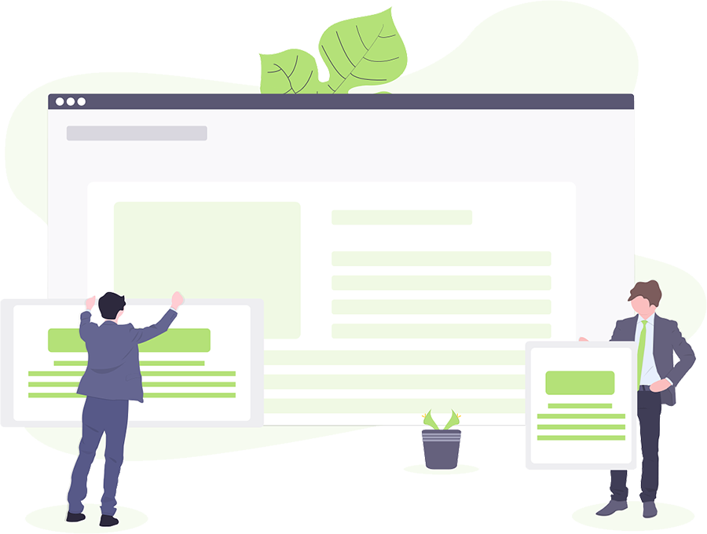
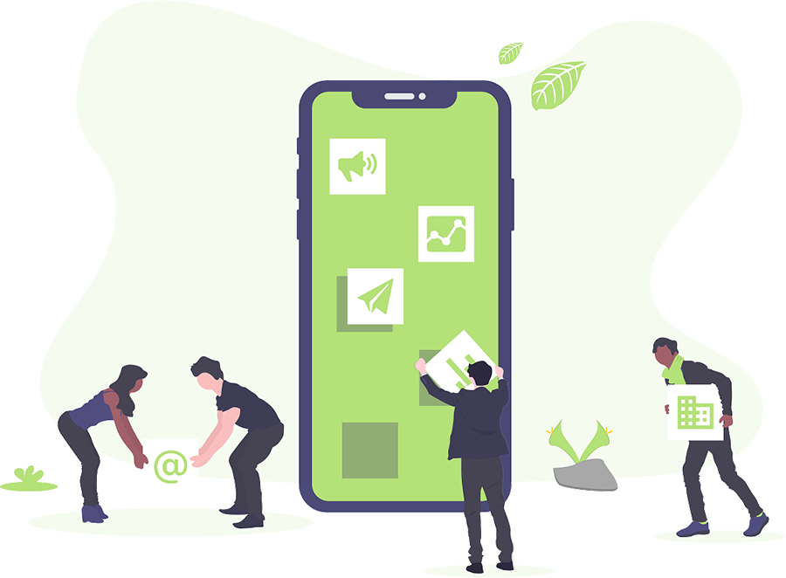
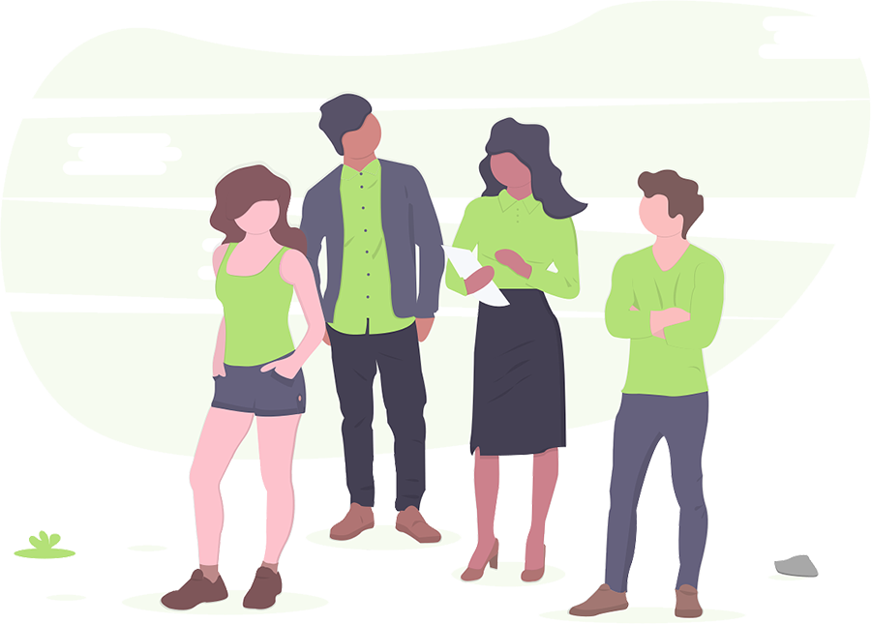
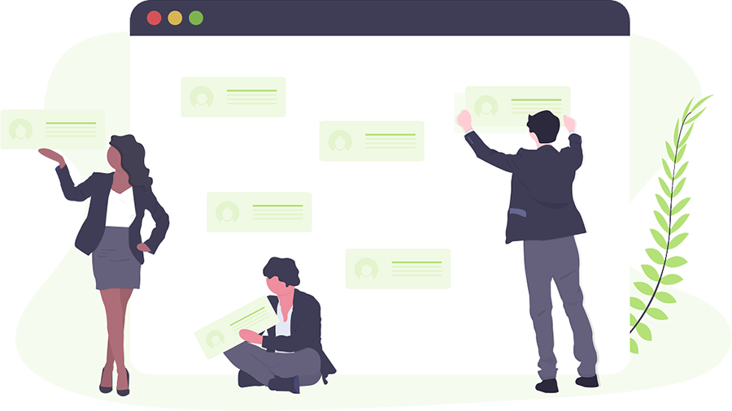
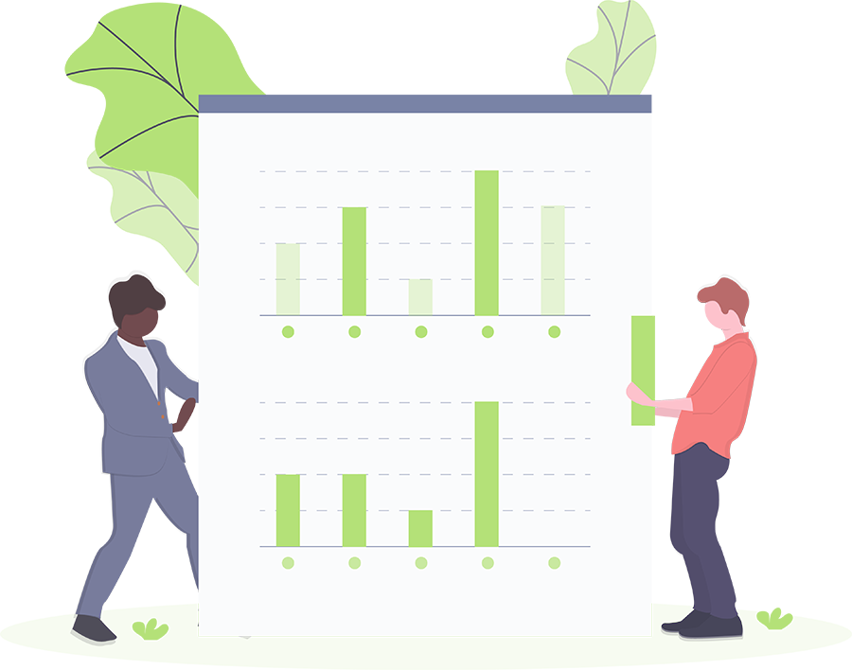
Illustrations by undraw.co (completely free and without attribution)

Slide 68
These icons are editable shapes. This means that you can:
Resize them without losing quality.
Change fill color and opacity.
Change line color, width and style.
Examples:

Slide 69
Diagrams and infographics

